Slide 1
WSUP18-0016 The Club at ArrowCreek Grading
Washoe County Board of Adjustment
September 6, 2018

Slide 2
Request
The application is requesting a special use permit to allow for the expansion of outdoor sports and recreation uses on the property, including a pool and pool building with a commercial kitchen and indoor seating, a golf practice area, putting green, chipping green, bocce ball courts, outdoor fitness area, members patio, golf practice area, expand the driving range and adding more area for golf cart parking.

Slide 3
Request
The special use permit also includes grading of approximately 13 acres of the 149 acre site with 33,100 cubic yards of cut and 29,800 cubic yards of fill and to allow slopes greater than 10 feet in height for re-grading and re-contouring for the proposed outdoor sports and recreation facilities.

Slide 5
Location

Slide 6
Background
The Club at ArrowCreek is located in the ArrowCreek Master Planned Community, which was originally approved in 1999
The Club at ArrowCreek was formed in 2000 when the two 18-hole golf courses were separated from the existing Club.

Slide 7
Background
The Club at ArrowCreek is a member only facility with two 18-hole golf courses, club house with dining, a driving range, and putting green
The adjacent ArrowCreek Resident Club facilities includes a club house, swimming pools, courts for tennis and pickle ball, basketball courts, and other facilities.

Slide 8
Background
The site has a regulatory zoning of Low Density Suburban (LDS) and High Density Rural (HDR), which requires a special use permit to expand outdoor sports and recreation use
The applicant indicates that the new recreational uses will enhance the facility and make the Club more versatile and attractive to existing members and potentially to new members.

Slide 9
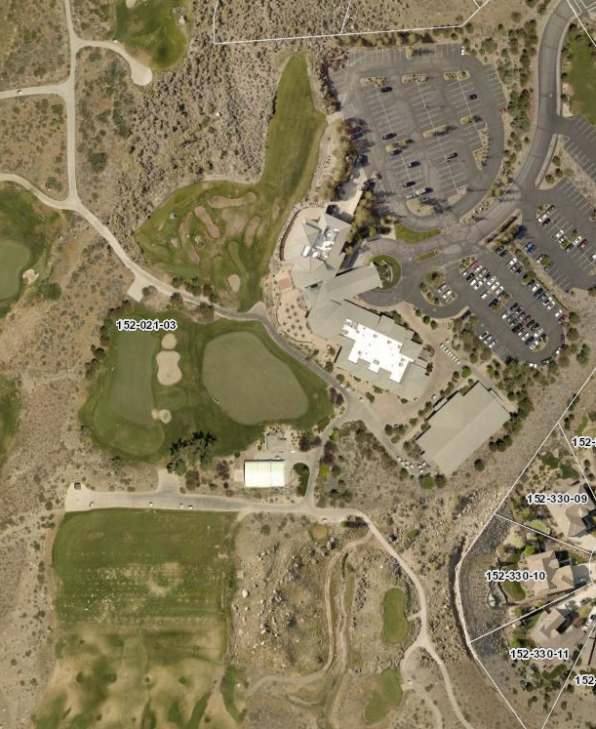

Slide 10
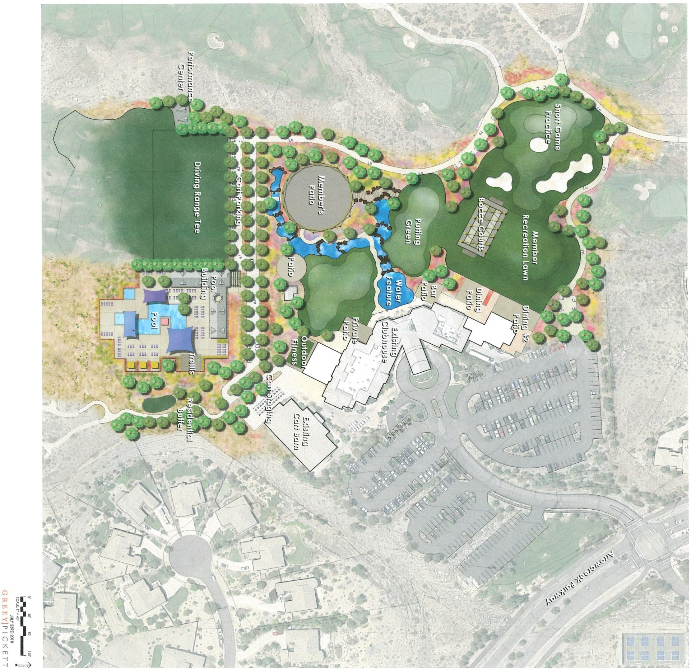

Slide 11
Background
The applicant will be re-grading and re-contouring the project area to accommodate for the new outdoor sports and recreation facilities.
The grading on the site does meets the requirement for a special use permit.

Slide 12
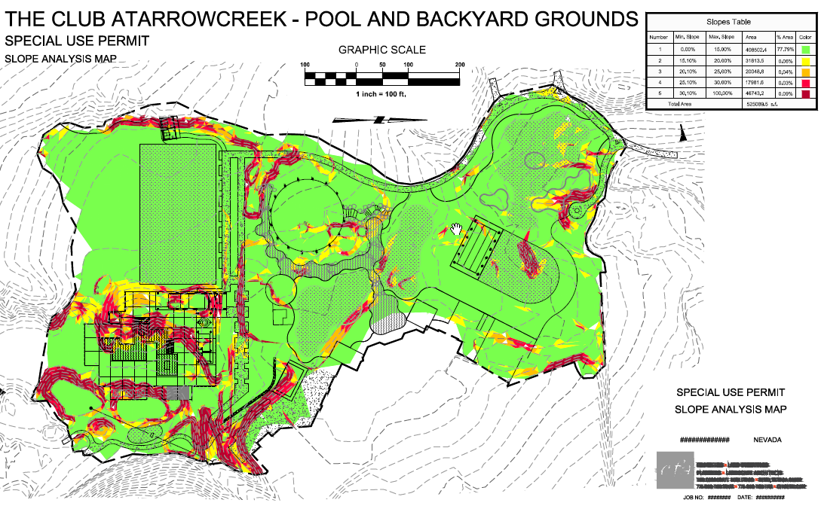

Slide 14
Analysis
Fill will be required around the pool and pool building and a retaining wall will be needed for the path leading to the pool area.
33,100 cubic yards will be excavated and 29,800 cubic yards will be filled
There will be 3,300 cubic yards of excess material which will be balanced on site and no material is expected to be exported or imported, except possibly for structural fill material needed around the pool area.

Slide 15
Analysis
The applicant is also requesting a modification of the requirement concerning the exposed finished grade of slopes greater than 10 feet in height.
The Board may consider and grant varying of standards as a component of this special use permit application.

Slide 16
Analysis
The applicant indicates that no improvements are needed to the roadways or parking area- more parking for golf carts, is proposed.
The site has significant landscaping and meets code, however landscaping will be added as needed around the new recreational facilities.
The applicant has worked to lessen any impacts with surrounding residential neighbors including blocking views, noise, and lighting.

Slide 17
Public Notice & CAB
Notices were sent to 294 affected property owners.
The South Truckee Meadows/Washoe Valley CAB reviewed the application on August 2, 2018 and recommended to approve the project.

Slide 18
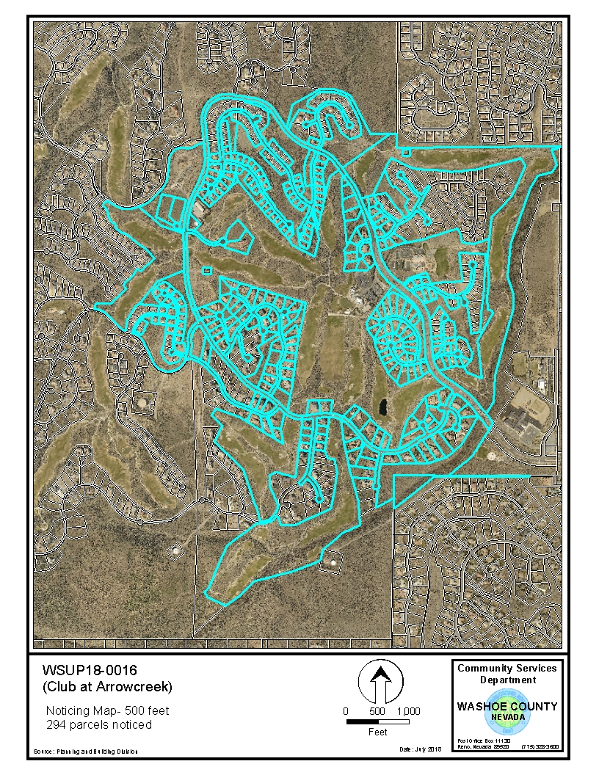

Slide 19
Reviewing Agencies
8 of the 11 reviewing agencies provided comments and 5 with conditions, which are included in your staff report.

Slide 20
Special Use Permit Findings
1. Consistency. That the proposed use is consistent with the action programs, policies, standards and maps of the Master Plan and the Southwest Area Plan.
2. Improvements. That adequate utilities, roadway improvements, sanitation, water supply, drainage, and other necessary facilities have been provided, the proposed improvements are properly related to existing and proposed roadways, and an adequate public facilities determination has been made in accordance with Division Seven.
3. Site Suitability. That the site is physically suitable for outdoor sports and recreation, grading and for the intensity of such a development.
4. Issuance Not Detrimental. That issuance of the permit will not be significantly detrimental to the public health, safety or welfare; injurious to the property or improvements of adjacent properties; or detrimental to the character of the surrounding area.
5. Effect on a Military Installation. Issuance of the permit will not have a detrimental effect on the location, purpose or mission of the military installation.

Slide 21
Special Us Permit Findings
Staff is able to make all the required findings, as detailed in the staff report on Page 13-14

Slide 22
Possible Motion
I move that, after giving reasoned consideration to the information contained in the staff report and information received during the public hearing, the Washoe County Board of Adjustment approve Special Use Permit Case Number WSUP18-0016 with conditions included in Exhibit A, having made all findings in accordance with Washoe County Code Section 110.810.30

